Slide 1
Predicting customer buying behaviour
SUBTITLE
Date

Slide 2
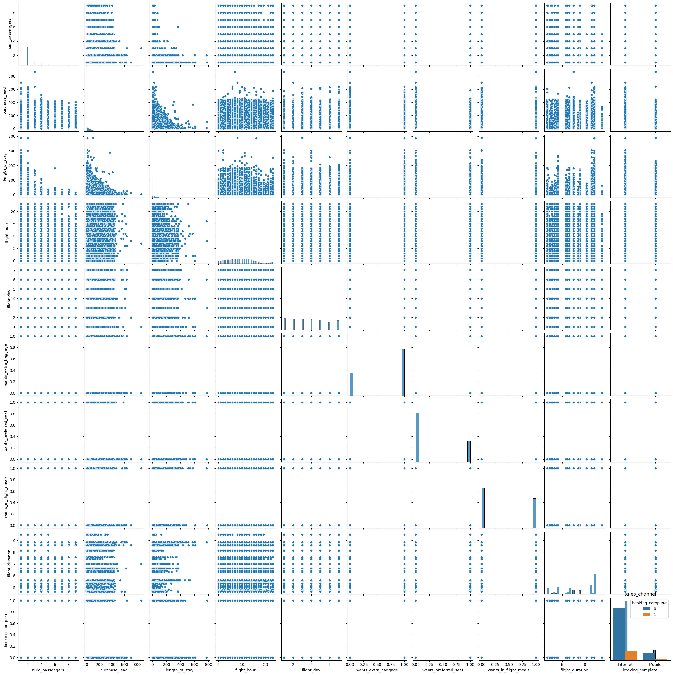
Graph
Interpretation:
No pattern in this pairplot

Slide 3
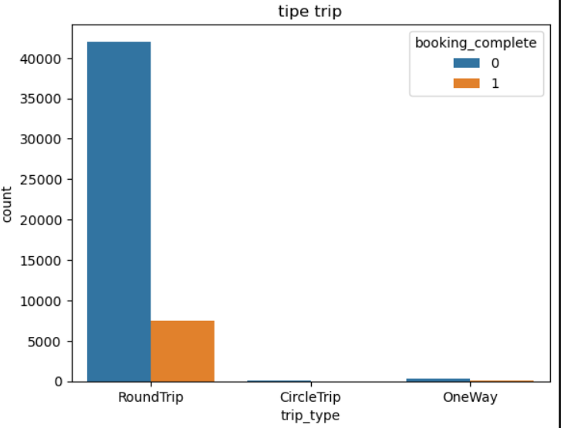
Graph
Interpretation:
No pattern in this bar chart

Slide 4
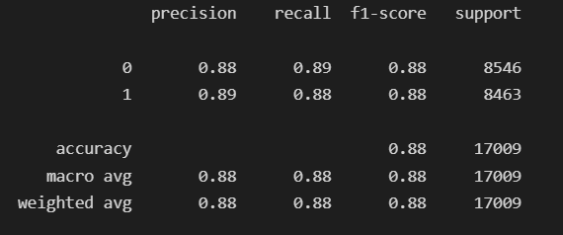
Graph
Interpretation:
Good for random forest

